Slide 1
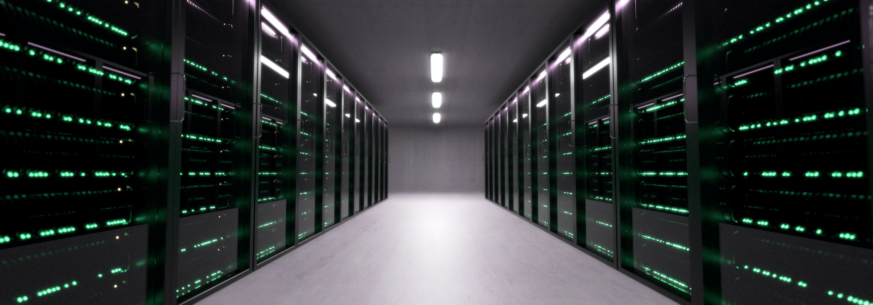
PDC syllabus

Slide 2
Unit 1
The state of computing, system attributes to performance, multiprocessors and multicomputer, multivector and SIMD computers, basics of parallel programming models, parallel algorithms and distributed processing,
Conditions of parallelism: Data, control and resource dependencies, Hardware and software parallelism. Hardware Taxonomy: Flynn’s classification, Shore’s classification, Feng’s classification, Handler’s classification. Software taxonomy: Kung’s taxonomy.

Slide 3
Parallel Computer Models
over the last two decades. computer and communication technologies have literally transformed the world we live in. Parallel processing has emerged as the key enabling technology in modern computers. driven by the ever-incrsing demand for higher performance. lower costs. and sustained productivity in real-life applications. Parallelism appears in various forms. such as look ahead. pipelining. vectorization. concurrency. simultaneity. data parallelism. partitioning. interleaving. overlapping. multiplicity. replication. time sharing. space sharing. multitasking. multiprogramming. multithreading. and distributed computing at different processing levels. in this chapter. we model physical architectures of parallel computers. vector supercomputers. multiprocessors. multicomputers. and massively parallel processors. Theoretical machine models are also presented.

Slide 4
Unit 2
Abstract parallel computational models: combinational circuits, sorting network, PRAM models, VLSI complexity model, architecture development tracks, program partitioning and scheduling, program flow mechanisms. Performance metrics and measures: parallelism profile in programs, mean performance, efficiency, utilization and quality, benchmarks and performance measures.
Parallel processing applications: Massive parallelism for grand challenges, application models for parallel computing, scalability of parallel algorithms. Speedup performance laws: Amdahl’s law for fixed workload, Gustafson’s Law for scaled problems and memory bounded speedup model. Scalability analysis and approaches: Scalability metrics and goals, evaluation of scalable computers.

Slide 5
Unit 3
Pipelining and Superscalar Techniques: Linear pipeline processors, nonlinear pipeline processors, arithmetic pipeline design, and superscalar pipeline design. Parallel programming models: Shared-variable model, message-passing model, data-parallel model, object-oriented model and functional and logic models. Case studies of parallel processors: ICL distributed array processor (DAP), ILLIAC IV Computer, Tilera’s TILE64 system, Sun UltraSparc T2 processor, Intel Pentium Processors.

Slide 6
SCALABILITYANALYSIS AND APPROACHES
The perfonnance of a computer system depends on a large number offactors, all affecting the scalability of the computer architecture and the application program involved. The simplest definition scalability of is that the performance of a computer system increases linearly with respect to the number of processors used for a given application,

Slide 7
Scalability Metrics and Goals
Scalability studies determine the degree of matching between a computer architecture and an application algorithm.
Thus, a good computer architecture should be efficient in implementing a large class of application algorithms. ln the ideal case, the computer performance should be linearly scalable w'ltl1 an increasing number of processors employed in implementing the algorithms.

Slide 8
Scalability metric:
Speedup and Efflcleney Revisited For a given architecture, algorithm, and problem size s, the asymptomatic speed up S(s, n) is the best speedup that is attainable, varying only the number tn} of processors. Let Tis, 1) be the sequential execution time on a uniprocessor, T(s, n) be the minimum parallel execution time on an n-processor system, and Ms, n) be the lump sum of all communication and UCI overheads. The asymptotic speedup is formally defined as follows:

